Slide 1
ENSE 471, Milestone 1
WalmartGreeters
Daris Lychuk, Taylor Petrychyn, Priscilla Chua
February 6th, 2019

Slide 2
Team introductions
Team members
Daris Lychuk 4th year SSE student
Taylor Petrychyn 4th year SSE student
Priscilla Chua 4th year SSE student
What’s your team name?
Walmart Greeters

Slide 3
Prep & review stage
Engineering Websites our team reviewed
  External universities reviewed
  Taylor - Reviewed University of Waterloo
  Daris - Reviewed University of Manitoba
  Priscilla - Reviewed University of Regina
Data from stakeholders perspective we used
  Current & future students are the primary goal, whether international or domestic
  Graduate students deciding where to study; research or other interests?
  Keeping all info current, easy to find, and easy to navigate with similar layout to main U of R site
  Website is the face to the world
  Dead links are very bad
  Brand the faculties better(Github, Facebook, Instagram)
    Have a grad student manage the social medias?

Slide 4
Prep & Review (cont.)
Overall (data gathered from all customer perspectives for all sites)
  What was liked
  Search bar at top was liked
  Consistency throughout the entire site
  Fairly easy to navigate/learn
  What was disliked
  Small text
  Broken links
  Sometimes navigation bars can be too busy
  Unused space
  Did any opportunities arise for innovative ideas?
  Perhaps the social media idea Trevor suggested?

Slide 5
Customers
Current Students - Priscilla
Currently enrolled students
Need information on how to complete their degree:
  Courses/classes to take
  Resources to get help
Future Students - Daris
- Potential students interested in a secondary education, whether domestic or international
  Programs offered
  Duration & cost
  Documents needed
  Pre-requisite information
  Contact information
Graduate Students - Taylor
Students pursuing/interested in a graduate program
  Grad programs offered
  Duration & cost
  Application

Slide 6
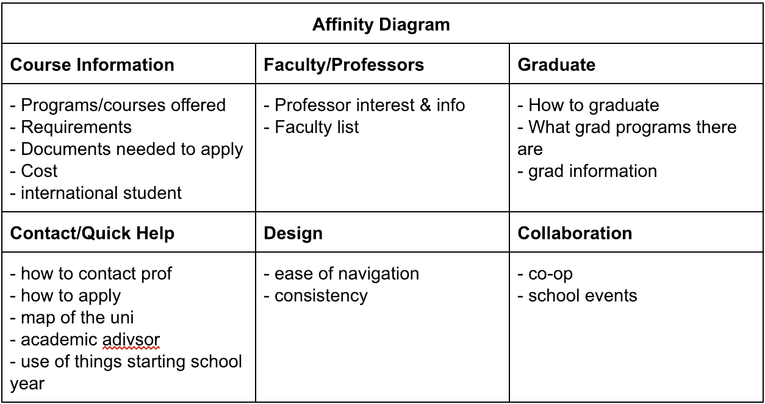

Slide 7
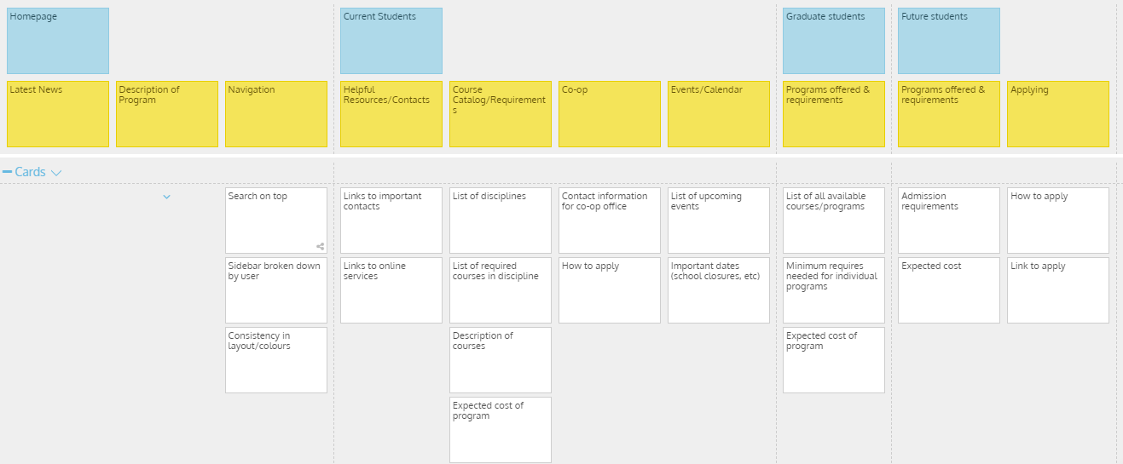
Frame stage
Notes:
Emphasize key scenarios (epics, user stories) that you will focus on for your team’s MVPs
Highlight your team’s first MVP
Why were these experiences deemed critical to the first MVP?
Ensure you discuss all target customers
Reminder – Each team member should individually discuss their target customer(s)

Slide 8
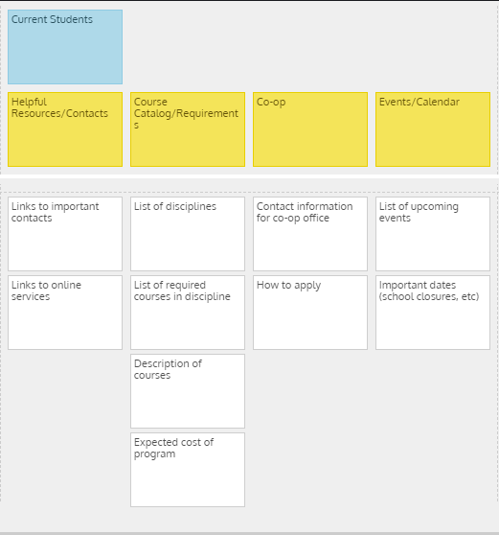

Slide 9
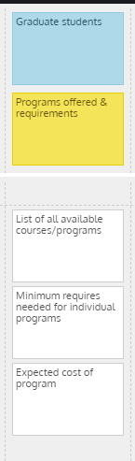
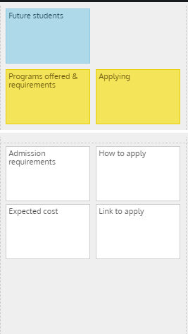

Slide 10
GitHub review
https://github.com/darislychuk/Walmart-Greeters

Slide 11
Group reflection
How did you feel about this milestone? What did you like about it? What did you dislike?
  Was helpful to be critical of our own engineering website and compare it to others to see where ours could improve.
What did you learn about yourself as you collaborated and worked through this milestone?
  Most users have similar wants/needs, however, and when we are designing this, we are one of the main users.
How will you use what you have learned going forward?
  Affinity diagrams are a great way to combine overlapping ideas and requirements.
What “stuff & things” related to this milestone would you want help with?
  Currently, there is nothing we need help with.

